Slide 1

Students will be able to converse well with effective speaking and listening skills in English.SRW SKILLS
LSRW- LISTENING, SPEAKING, READING, WRITING

Slide 2

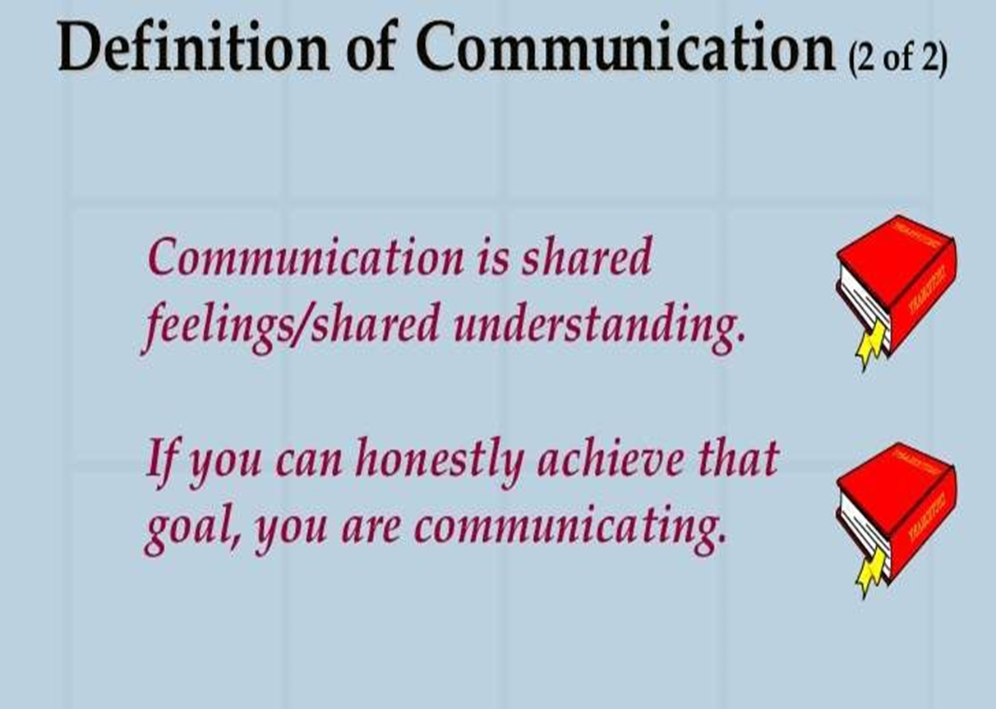
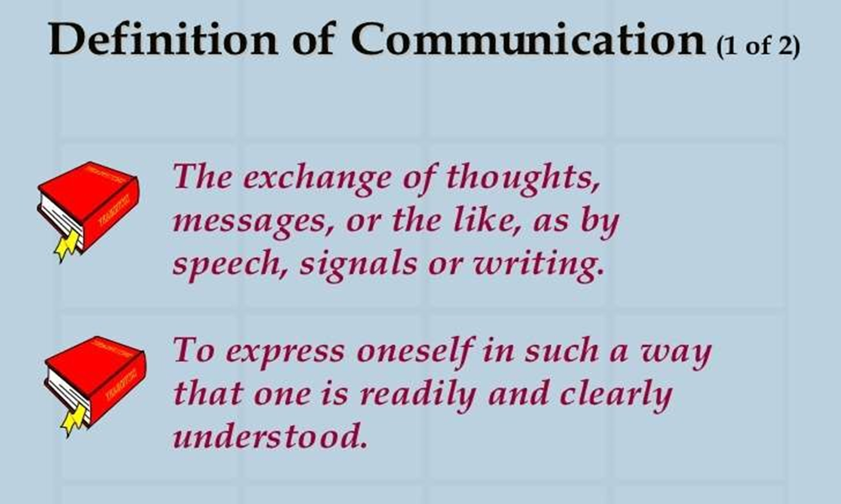
Communication

Slide 3
After studying this unit you will know
Active Listening: Meaning and Art of Listening
Process and Types of Listening
Traits of a Good Listener, Ten Thumb Rules for Listening
,
Listening Techniques using Ted Talk Audio listening with script reading
Listening and Note taking
Pronunciation, Speaking Style & Content

Slide 4
Components of Communication
Listening Skill
Speaking Skill
Reading Skill
Writing Skill

Slide 5
For communication process
one should recognize and understand the various sounds of a language
Then he/she should learn to discriminate between the different sounds
This is possible only if the learner gets an opportunity to listen speeches made by adults
Then only one can acquire the ability to speak
After speaking comes reading
Last of all comes writing

Slide 6
Communication Skills
The listening and reading skills are called Receptive Skills (Passive Skills)
While listening and reading the communicator is at the receiving end
Speaking and writing are called Productive Skills (Active Skills)
While speaking and writing the communicator is at the transmitting end

Slide 7
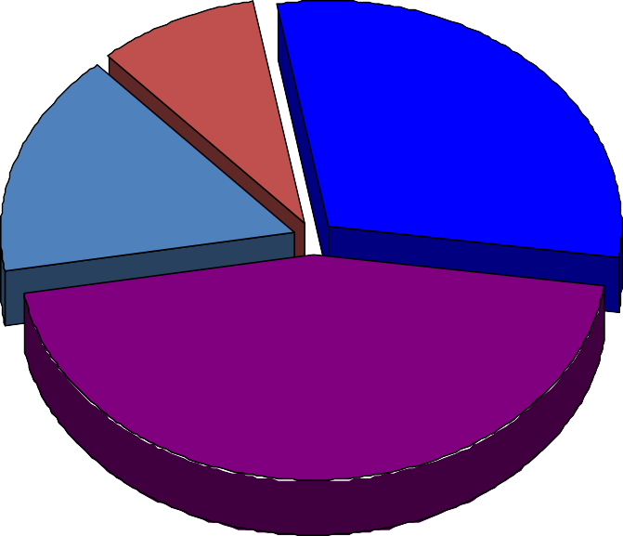
TOTAL COMMUNICATION PROCESS
Writing 9%
Speaking 30%
Reading 16%
Listening 45%

Slide 8

Active listening

Slide 9

Listening
Listening is the most important communication skill.
We probably spend more time using our Listening Skills than any other kind of skill
Real Listening is an active process
Listening requires attention

Slide 10
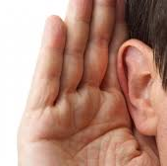
Effective listening
Effective Listening is the process of analyzing sounds, organizing them into recognizable patterns, interpreting the patterns and understanding the message by inferring the meaning.
Many of the problems we experience with people in our daily lives are primarily attributable to ineffective listening or lack of listening

Slide 11

Listening comes first
LISTENING
SPEAKING
READING
WRITING
11

Slide 12
Listening is not hearing
Listening and hearing are not the same. Hearing is the first stage of listening.
Hearing occurs when our ears pick up sound waves which are then transported to our brain.This stage is our sense of hearing.

Slide 13
Listening Skill
The skill of listening is the ability to receive and understand different speech sounds of a language
It is the training of one’s ears to understand and discriminate the meaningful messages communicated by the sounds of a language

Slide 14
Importance of listening
Communication is not complete without effective listening
An attentive listener stimulates better speaking by the speaker
A good listener learns more than an indifferent listener
A good listener can restructure vague speaking in a way that produces clearer meaning
A good listener learns to detect prejudices, assumptions and
attitudes

Slide 15

Active listening process
Hearing
Filtering
Comprehending
Remembering
Responding

Slide 16

HEARING
Hearing is the first essential step in the listening process
Relates to the sensory perception of sound.
For learning to be effective, hearing needs to be done with attentiveness and concentration.

Slide 17
FILTERING
Involves sensing and filtering of heard sounds.
The heard message is categorized as wanted or unwanted.
The unwanted message is discarded.
The sense of judgement of the individual comes into play, that is, the filtering process is subjective
A person chooses to retain what makes sense to him.

Slide 18
COMPREHENDING
The listener understands what the speaker has tried to convey
This activity can be described as absorbing, grasping or assimilating
The listener uses his knowledge, experience, perception and cognitive power.

Slide 19

REMEMBERING
The assimilated message is stored in memory to facilitate future recall.

Slide 20

RESPONDING
Responding to a message takes place at the end of the communication, immediately after or later, to show that the message is being received and comprehended.

Slide 21
TYPES OF LISTENING
By: Dr. Seema Verma (Assistant Professor) Department of Applied Sciences & Humanities
ABES Engineering College, Ghaziabad

Slide 22
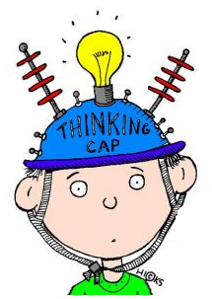




Informative Listening
Appreciative Listening
Comprehensive
Listening
Types Of Listening
Empathetic Listening
Critical Listening

Slide 23
Types of Listening
Appreciative Listening- this for deriving aesthetic pleasure, Listening for fun—to laugh, cry, use your imagination, or extend your creativity as we do when we listen to a comedian,musician or entertainer.
Empathetic Listening- we provide emotional and moral support in the form of it. You try to put yourself in another person’s place or see the world through his or her eyes e.g psychiatrists listening to their patients.

Slide 24
Comprehensive –listening to comprehend ideas and information in order to achieve a specific purpose or goal e.g listen to lecture and Listening to announcements
Critical Listening: Listening to understand, analyze, and evaluate messages so you can accept or reject a point of view, make a decision, or take action
when the purpose is to accept or reject the message or evaluate it critically. e.g listening to sales person before making purchase or listening to politicians .

Slide 25
HOW TO IMPROVE LISTENING SKILLS
By: Dr. Seema Verma (Assistant Professor) Department of Applied Sciences & Humanities
ABES Engineering College, Ghaziabad

Slide 26
The 10 Principles of Listening
1. Stop Talking
“If we were supposed to talk more than we listen, we would have two tongues and one ear.” -Mark Twain.
Don't talk, listen. When somebody else is talking listen to what they are saying, do not interrupt, talk over them or finish their sentences for them. Stop, just listen. When the other person has finished talking you may need to clarify to ensure you have received their message accurately
2. Prepare Yourself to Listen
Relax. Focus on the speaker. Put other things out of mind. The human mind is easily distracted by other thoughts – what’s for lunch, what time do I need to leave to catch my train, is it going to rain – try to put other thoughts out of mind and concentrate on the messages that are being Communicated

Slide 27
The 10 Principles of Listening
3. Put the Speaker at Ease : Help the speaker to feel free to speak. Remember their needs and concerns. Nod or use other gestures or words to encourage them to continue. Maintain eye contact but don’t stare – show you are listening and understanding what is being said.
4. Remove Distractions :Focus on what is being said: don’t doodle, shuffle papers, look out the window, and pick your fingernails or similar. Avoid unnecessary interruptions. These behaviours disrupt the listening process and send messages to the speaker that you are bored or distracted.

Slide 28
The 10 Principles of Listening
5. Empathise : Try to understand the other person’s point of view. Look at issues from their perspective. Let go of preconceived ideas. By having an open mind we can more fully empathise with the speaker. If the speaker says something that you disagree with then wait and construct an argument to counter what is said but keep an open mind to the views and opinions of others.
6. Be Patient : A pause, even a long pause, does not necessarily mean that the speaker has finished. Be patient and let the speaker continue in their own time, sometimes it takes time to formulate what to say and how to say it. Never interrupt or finish a sentence for someone.

Slide 29
The 10 Principles of Listening
7. Avoid Personal Prejudice: Try to be impartial. Don't become irritated and don't let the person’s habits or mannerisms distract you from what they are really saying. Everybody has a different way of speaking – some people are for example more nervous or shy than others, some have regional accents or make excessive arm movements, some people like to pace whilst talking - others like to sit still. Focus on what is being said and try to ignore styles of delivery.
8. Listen to the Tone :Volume and tone both add to what someone is saying. A good speaker will use both volume and tone to their advantage to keep an audience attentive; everybody will use pitch, tone and volume of voice in certain situations – let these help you to understand the emphasis of what is being said

Slide 30
The 10 Principles of Listening
9. Listen for Ideas – Not Just Words :You need to get the whole picture, not just isolated bits and pieces. Maybe one of the most difficult aspects of listening is the ability to link together pieces of information to reveal the ideas of others. With proper concentration, letting go of distractions, and focus this becomes easier.
10. Wait and Watch for Non-Verbal Communication :Gestures, facial expressions, and eye-movements can all be important. We don’t just listen with our ears but also with our eyes – watch and pick up the additional information being transmitted via non-verbal communication. Do not jump to conclusions about what you see and hear. You should always seek clarification to ensure that your understanding is correct.

Slide 31
Difference between hearing and LISTENING
LISTENING
Listening means to interpret the noise, understanding it and provide an adequate response to it.
Listening is a conscious choice that demands your attention and concentration.
Listening is a skill that can be learned.
HEARING
Hearing only refers to your ears picking up noise.
Hearing is a passive occurrence that requires no effort.
Hearing is a physical ability.

Slide 32
Hearing is considered to be a biological phenomenon.
In hearing, after the brain receives the nerve impulses it may or may not sends feedback.
Listening is biological as well as psychological process.
In listening , after the brain receives the nerve impulses and deciphers it ,it then sends feedback.

Slide 33
Basis of Distinction | Active Listening | Passive Listening
Definition | Active listening means mindful and actively hearing and attempting to comprehend the meaning of the speakers. | Passive listening means showing like listening to the speaker but not making an attempt to comprehend the meanings.
Connectivity Level | Listener connects with the world and actively participates with the goal of problem-solving | Listener disconnects himself from the outsiders and has minimal interaction with others
Self-Responsibility | Take responsibility for their own learning and growth | Avoids responsibility for learning and problem-solving
Mental Approach | Sharp mind, alert to explore, reflect on the information | Accepts and retain information as-is with no intention to question or challenge the idea for improvement
Self-Motivation Level | Strong | Weak
Engagement Level | High | Low
Will-Power | Strong-willed, interested in new ideas, open-minded | Narrow-minded, low or no will power, unreceptive to new ideas

Slide 34
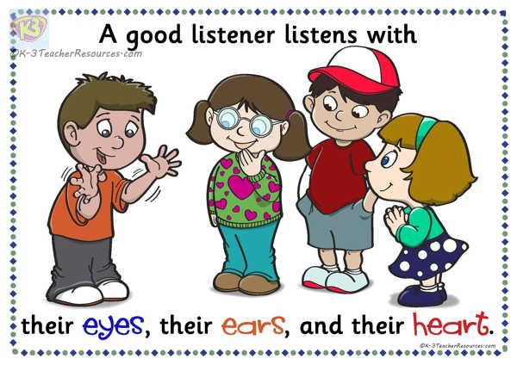
Traits of a good listener
Ten Traits of a Good Listener
They-
Hear you out – free of judgment.
See both sides of the story.
Know when to step in.
Put themselves at speaker’s place
Follow up on their promises.
Give the speaker their undivided attention
Provide appropriate nonverbal communication
Pace the conversation
Recall previous information

Slide 35
Effective Listening & Note-Taking
One way to enhance listening
Using a systematic approach to the taking and reviewing of your notes
Add immeasurably to your understanding and remembering of the content of lectures.
a permanent record of key information
helps you distinguish where your ideas came from and how and what you think about those ideas.

Slide 36
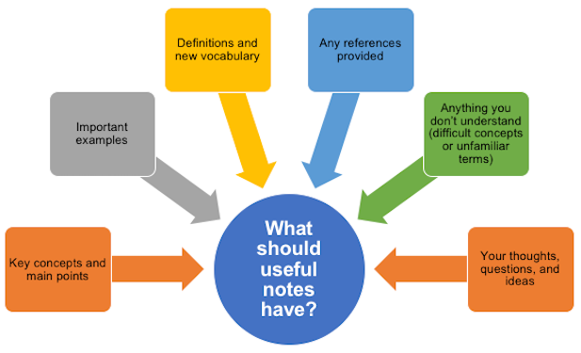
Effective Listening & Note-taking

Slide 37

Six good reasons to take notes
Notes are a useful record of key information, and the sources of that information.
Writing notes helps you remember what you heard.
Taking notes helps you to concentrate and listen effectively.
Selecting what to note down increases your understanding.
Notes create a resource for exam preparation.
Notes taken in classes often contain information that can’t be found elsewhere.

Slide 38

Before Class
Develop a mind-set geared toward listening.
Test yourself over the previous lecture while waiting for the next one to begin.
Read assigned material (SQ3R) or at least S (skim) and Q (question) to acquaint yourself with main ideas, new terms, etc.
Do what you can to improve physical and mental alertness
Choose notebooks that will enhance your systematic note-taking(Cornell System of Note-taking)
Intend to listen.

Slide 39

During Class
Listen for the structure and information in the lecture. Use signal words such as:
“Today I want to cover...” Introduction and/or Title
“Four points...” “Three causes...” Organizational cues
“Next I want to discuss...” Change of topic
“I emphasize...” “To repeat...” Cues regarding importance
Pay attention to the speaker for verbal (louder or higher pitched inflections) and body language cues of what’s important.
Be consistent in your use of form, abbreviations, etc. (key your abbreviations).

Slide 40
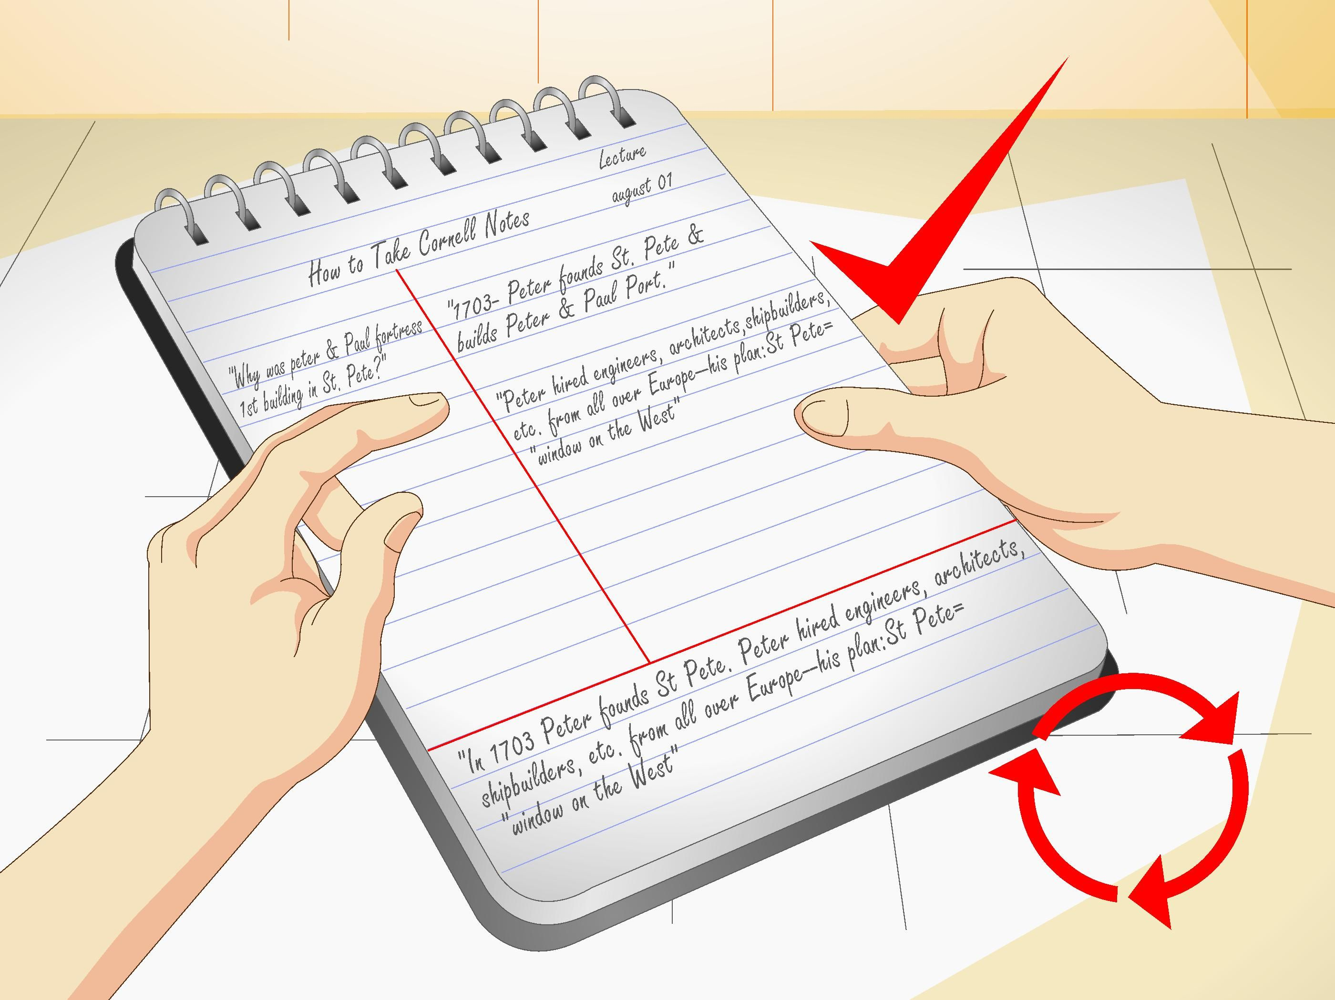
During Class
Make a conscious effort to concentrate on what the speaker is saying
Label important points and organizational clues: main points, examples.
Ask questions if you don’t understand.
Instead of closing your notebook early and getting ready to leave, listen carefully to information given toward the end of class.

Slide 41
After Class: SAME DAY AS LECTURE (Reduce, Recite, Reflect)
Clear up any questions raised by the lecture by asking either the teacher or classmates.
Fill in missing points or misunderstood terms from text or other sources.
Edit your notes, labeling main points, adding recall clues and questions to be answered. Key points in the notes can be highlighted with different colors of ink.
Make note of your ideas and reflections, keeping them separate from those of the speaker.

Slide 42
After The Class
Clear up any questions raised by the lecture by asking either the teacher or classmates.
Fill in missing points or misunderstood terms from text or other sources.
Edit your notes, labeling main points, adding recall clues and questions to be answered. Key points in the notes can be highlighted with different colors of ink.
Make note of your ideas and reflections, keeping them separate from those of the speaker.

Slide 43
After The Class
A checklist for editing your notes:
Did you state the main topic of the lecture?
Are all words intelligible?
Are symbols and abbreviations keyed?
Is the structure clear? If not, you may need to rewrite.
Did you write cue words in the left margin for self-testing?
Did you miss any points? You may need to compare notes with a classmate.

Slide 44
After The Class
Periodically (Review)
Review your notes: glance at your recall clues and see how much you can remember before rereading the notes.
Look for the emergence of themes, main concepts, methods of presentation over the course of several lectures.
Make up and answer possible test questions.

Slide 45
TED TALK-INTRODUCTION
A TED talk is a recorded public-speaking presentation that was originally given at the main TED(technology, entertainment & design)annual event or one of its many satellite events around the world.
A non-profit devoted to spreading ideas, usually in the form of short, powerful talks, often called “TED” talks.
Limited to a maximum length of 18 minutes but may be on any topic.
The Ted organization was founded by Richard Saul Wurman, and the TED conference was co-founded by Harry Marks in February 1984.
The first TED conference was in 1984 and the conference has been held annually since 1990.
Initially, the focus of TED conferences was technology, design and entertainment.

Slide 46
POPULAR TED TALKS:
POPULAR TED TALKS :
“ The interspecies internet? An idea in progress”
“ Anatomy of a New Yorker cartoon”
“ Why we should build wooden skyscrapers”
“ The curly fry conundrum: Why social media ‘likes’ say more than you might think”
Meet global corruption's hidden players”
“ How we’ll resurrect the gastric-brooding frog, the Tasmanian tiger”
“ Ingenuity and elegance in ancient African alphabets”
“ The dangers of wilful blindness”
What ants teach us about the brain, cancer, and the Internet”
“ Why we sleep”
“ The history of TED talks”

Slide 47

Listening Techniques using Ted Talk Audio listening with script reading
The Power of Listening
This talk is about the importance of listening to the people when they talk to you. Sometimes people don't need advice, they just need somebody to listen.
https://www.ted.com/talks/the_power_of_listening
This talk was presented to a local audience at TEDxYouth@ASFM, an independent event.
TEDx was created in the spirit of TED's mission, "ideas worth spreading." It supports independent organizers who want to create a TED-like event in their own community.
https://www.ted.com/talks/julian_treasure_5_ways_to_listen_better/transcript

Slide 48

Speaking Skills

Slide 49
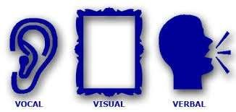
W h a t A r e S p e a k I n g s K I L L S?
7%
Verbal
(words spoken)
38%
Vocal
(tone, range, appeal, credibility of voice)
Visual
(physical appearance, gestures, eye contact)
55%

Slide 50
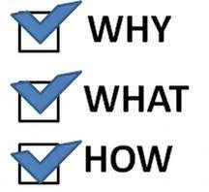
Speaking consist of 3parts
To Speak
To Speak.
To Speak

Slide 51
Speaking skill
Speaking skill is the art of communications and one of 4 productive skill, that must be mastered in learning foreign language.
Good speaking skills is the act of generating words that can be understood by listeners.
A good speaker is clear and informative.

Slide 52
Elements of good speaking
Articulation
Pronunciation
Voice quality
Accent
Intonation
Pause
Punctuation

Slide 53
Guidelines for speaking
Speed
Clarity
Punctuation
Pronunciation
Familiarity
Fluency
Expressions

Slide 54
The speaking skill
A person who can speak English can:
Produce the characteristic English speech sounds and sound patterns both in isolation and combination.
Use appropriate stress and intonation patterns.
Use appropriate words and structures to express the intended meanings.
Recall words and structures.
Organize thoughts and ideas into logical sequence.
Adjust speech according to audience.

Slide 55

Stress
Stress is the degree of force with which a syllable or a word is uttered.
It is also defined as the degree of prominence a syllable has.
Words with more than one syllables have a stressed syllable. In /teibl/ first syllable is prominent.
In committee and recommend second syllable is stressed.

Slide 56
What is Word Stress?
In English, we do not say each syllable with the same force or strength. In one word, we accentuate ONE syllable. We say one syllable very loudly (big, strong, important) and all the other syllables very quietly.

Slide 57

Activity
Let's take 3 words: photograph, photographer and photographic
Do they sound the same when spoken?

Slide 58
Rules for word stress
One word, one stress. (One word cannot have two stresses. So if you hear two stresses, you have heard two words, not one word.)
The stress is always on a vowel.

Slide 59

Why stress is crucial in English
Stress is crucial in English pronunciation. It can be called a grammatical device in English.
A part of the meanings of a word depends on stress. it serves to mark the function of words in spoken English.

Slide 60
Types of stress
1-word stress :It shows that what syllable in a word is stressed e.g. useful, is stressed on the first syllable, advantageous has a primary stress on first and secondary stress on third syllable.
2-Sentence stress: It shows what words in a sentence are stressed

Slide 61
Syllable
A syllable may be defined as a unit of sound with one vowel sound and with or without consonant sounds.
A syllable is the sound of a vowel (a, e, i, o, u) that is created when pronouncing a word.
A syllable is a part of a word that is pronounced with one uninterrupted sound.
A syllable is a unit of sound which can be pronounced with a single effort of the voice.
For example, the word water is composed of two syllables: wa and ter as we have to make two efforts to pronounce this word.

Slide 62

Syllable
i) word- one syllable, word
ii) spelling- two syllables, spe + lling
computer- three syllables com + pu + ter
The construction of a syllable may be described in terms of the following formula:
[C]+V=Syllable
Where C indicates indefinite number of consonants and V stands for a vowel sound, the bracket indicate that the consonants are not obligatory.
street = CCCVC (1 Syllable)
ago = VCV (2 Syllables)

Slide 63
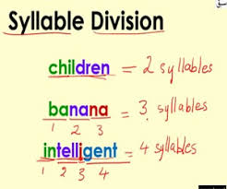
Types of syllable
Words are divided in to three types as per number of syllables:
Monosyllabic: Words with one syllable e.g. on- on (VC)
Disyllabic: Words with two syllables e.g. upon- up+ on (VCVC)
Polysyllabic: Words with more than two syllables e.g. syllable – sy+lla+ble (CVCVCVC)

Slide 64
TONGUE TWISTERS
A phrase that is designed to be
difficult to say…

Slide 65
Tongue Twisters
Listening and trying to say tongue twisters is one way to improve your English pronunciation. They are fun to try and are a challenge for anyone! So don't worry if you make mistakes. Just have fun!
Examples:
Peter Piper picked a peck of pickled peppers. A peck of pickled peppers Peter Piper picked. If Peter Piper picked a peck of pickled peppers, Where’s the peck of pickled peppers Peter Piper picked?

Slide 66

Tongue Twisters
Betty Botter bought a bit of butter. The butter Betty Botter bought was a bit bitter And made her batter bitter. But a bit of better butter makes better batter. So Betty Botter bought a bit of better butter Making Betty Botter's bitter batter better.
A big bug bit a bold bald bear and the bold bald bear bled blood badly.
How much wood would a woodchuck chuck if a woodchuck could chuck wood? He would chuck, he would, as much as he could, and chuck as much wood as a woodchuck would if a woodchuck could chuck wood.

Slide 69

Reading Skill

Slide 70

When do we use reading
To learn the script of a language •
To learn concepts of any topic in details •
To get entertained •
To get directions •
To understand instructions
In fact, Reading is the source of most of our information.

Slide 71

4 styles of reading a text
Depending on our purpose of reading, we adopt any of the four styles generally:
Skimming
• Scanning
• Churning
• Assimilating

Slide 72
Skimming
Fast browsing of the entire passage.
1
We get a rough idea about the topic of the passage
2
Humans have an inborn habit of trying to do things efficiently. They need to save time.
3
When we are searching for an information, and we have a large number of texts to choose from, we do a fast-browsing to decide which texts to read, and which to reject.
4

Slide 73

Scanning
Look for specific information in the text
It makes you “skip more than you read.”
Also called search reading

Slide 74
Churning
Churning means interpretation and inference.
Churning
v
Interpretation: Getting the summary of all the important points on a topic.
Inference: Reading between the lines. Understanding facts that are not stated openly.

Slide 75

Interpretation: How is it done?
Depending on the question, we need to decide what angle we are going to take, to interpret a text.
Generally, a text contains discussion on more than one keyword. You have to collect information on the specific keyword that is asked in the question.

Slide 76

Techniques to do Churning
Churning Techniques = Understanding 2 things:
Word Meaning
Coherence

Slide 77
Word Meanings
Understanding different meaning based on contexts.
Guess the unknown words from context.
Guess meaning from root words.
Read not the sentence, but sense-groups.
Try to get an overview beforehand.

Slide 78
Discourse Markers
• Discourse markers are words that come at the beginning of sentences, like ‘clearly’, ‘therefore’, ‘lastly’, ‘on the other hand’, ‘however’, etc.
They indicate whether the sentence is an example, a conclusion, or an opposite opinion.
They help us understand how an idea is developed in a passage.

Slide 79
Reading Style 4 : Assimilating
When we attempt to make a mental map of the entire passage that we have read, it is called assimilating.
When we say we have understood a concept after reading a chapter, we have actually done assimilation.

Slide 80
Steps to do Assimilation
Churning has made available the information. Convert the information into an idea. Think about it at a personal level.
Look for pictures, videos and other texts related to the topic to get better knowledge.
• Discuss with peers to get their view-points as well.
• This will help you plant a mental-map of the information you have read.

Slide 81
Writing
The act or art of forming letters and characters on paper, wood, stone, or other material, for the purpose of recording the ideas which characters and words express, or of communicating them to others by visible signs.
Objectives:
Creates a permanent record
• Allows you to store information for future reference
• Easily distributed
• All recipients receive the same information
• Necessary for legal and binding documentation

Slide 82











Three-Step Writing Process
Three-Step Writing Process
Step 1 Step 2 Step 3
Planning
Writing
Quality controll

Slide 83
The Writing Process
Planning
Keep objectives in mind and research the topic
Think about the audience
Outlining helps organize thoughts

Slide 84
The Writing Process
Writing
Follow your outline, use your handbook
Inspiration is acceptable but must be carefully reviewed
Use the interview approach to supplement the outline (who, what, where, when, how)

Slide 85
The Writing Process
Quality Control
Reread your work
Be critical of your own work

Slide 86
Considerations while writing
Who?
What?
When?
Why?
Where?
How?

Slide 87
Good Writing
Completeness: all information needed is provided
Correctness: relevant and precise information
Credibility: support your argument
Clarity: should not be vague, confusing, ambiguous
Conciseness: to the point
Consideration: anticipate the reader’s reaction
Vitality: use the active voice rather than the passive voice

Slide 88
Types of Writing
E-mails
Letters and Memos
Agendas
Reports
Promotional Material
Academic Documents
Research (scientific) manuscripts
White Papers

Slide 89
The Process of Writing
Prewriting
Publishing and Presenting
Drafting
Editing Proofreading
Revising

Slide 90
The Process of Writing
Prewriting is the stage in which you explore possible topics, choose a topic, and then gather details you can include in your writing.
Drafting involves putting ideas down on paper in a rough format.

Slide 91
Revising is the stage in which you rework your rough draft to improve both its form and its content.
Editing and proofreading are the stages in which you polish your writing, fixing errors in grammar, spelling, and mechanics.
Publishing and presenting are the sharing of your writing.

Slide 92
COMMON ETIQUETTES IN WRITTEN COMMUNICATION
Focus on format
Structure the content
Ensure consistency
Create balanced impression
Focus on Grammar
Check creativity & clarity
Consider the audience

Slide 93
CONCLUSION
Utilize full potential of written communication
What you write will ultimately define you as a professional to your colleagues and superiors
Match the appropriate communication method to the recipient
Eliminating excessive or unnecessary communication will improve your workflow
Mastering these skills will improve your ability and enhance your career.

Slide 94
BOOKS PRESCRIBED
Technical Communication, (Second Ed.); O.U.P., Meenakshi Raman & S. Sharma New Delhi,
2011.
2. Business Communication for Managers, Payal Mehra, Pearson, Delhi, 2012.
3. Personality Development, Harold R. Wallace et. al, Cengage Learning India Pvt. Ltd; New Delhi
2006.
4. Practical Communication by L.U.B. Pandey; A.I.T.B.S. Publications India Ltd.; Krishan Nagar,
Delhi 2013.
5. Personality Development & Soft Skills, Barun K.Mitra, Oxford University Press, New Delhi, 2012.

Slide 95
THANK YOU.

